Slide 1


Seall an taigh.
Tha e cho geal ris an t-sneachda.
Notes:
Look at the house.
It’s as white as (the) snow.

Slide 2
Seall am mullach.
Tha e cho glas ri ailbhean.
Notes:
Look at the roof.
It’s as grey as an elephant.

Slide 3

Seall an doras.
Tha e cho dearg ri ubhal.
Notes:
Look at the door.
It’s as red as an apple.

Slide 4
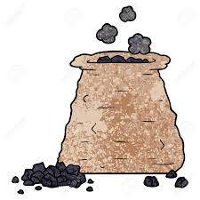
Seall an cat.
Tha e cho dubh ris a’ ghual.
Notes:
Look at the cat.
It’s as black as (the) coal.

